Slide 1

Computer Vision Labs
Oumayma MAHFOUDHI
Mariem Selmi
3DNI 1

Slide 2
Plan
01
03
Lab 3
Introduction
02
Lab 2
06
Conclusion

Slide 3
Introduction
Artificial intelligence
Machine learning
Deep learning

Slide 4
Lab 2
01
02
Part 1
Part 2
Face detection application
Model Deployment with Python and Streamlit

Slide 5
Part 1 : face detection application
Finding Faces in a New Image
04
Evaluating the Best Face Detector
03
Binary Classification using Scikit-Learn
02
Feature Engineering
01

Slide 6
Les fonctions utilisés
01
02
03
04
Color.rgb2gray()
Resize()
shape
Imread()
05
06
07
subplot()
Imshow()
HOG

Slide 7
Lab 2 Estimator
03
01
RandomForestClassifier
Estimator
SVM
05
06
DecisionTreeClassifier
KNeighborsClassifier

Slide 8
Part 2 : Model Deployment
01
Github
Face Detection application
02
Streamlit

Slide 9
Lab 3
Deep learning
The model
Detects skin cancer
Input 1
Input 2
Malignant
Benign

Slide 10
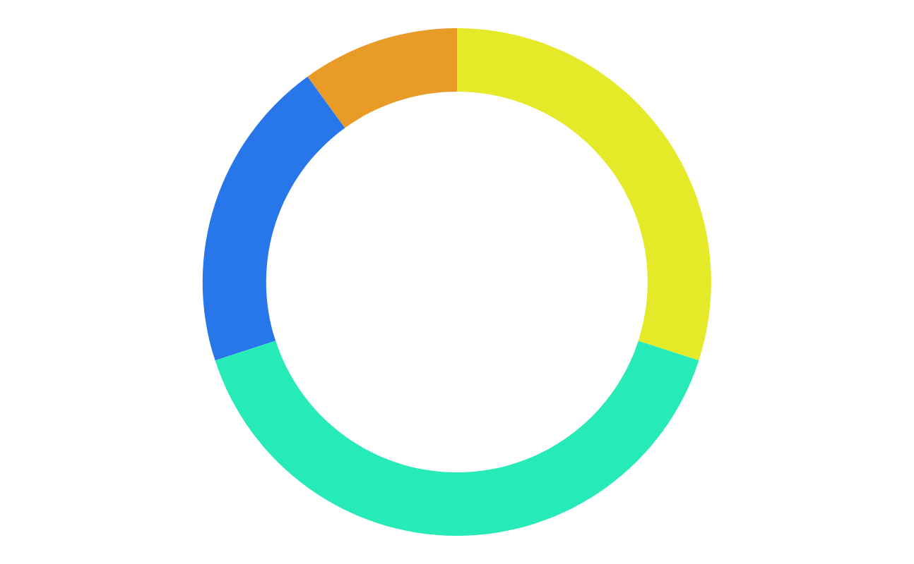
Keras
1
3
Larger community support
Keras supports both convolution and recurrent network
2
4
Easy to test
Keras neural networks are written in Python which makes things simpler

Slide 11
Neural network
01
Dense
02
Flatten
03
Conv2D
04
Dropout

Slide 12
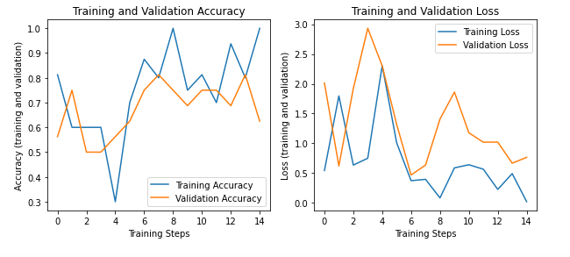
Performance

Slide 13
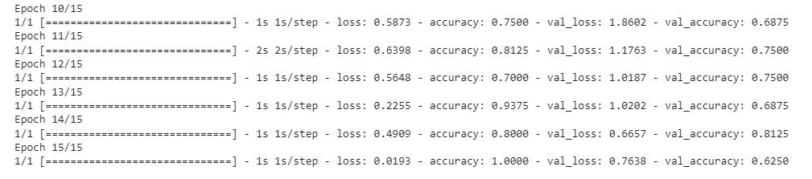
Best accuracy

Slide 14
Conclusion
01 | Supervised learning
02 | Unsupervised learning
03 | Semi-supervised learning
04 | Reinforcement learning
05 | Dimensionality reduction

